Slide 1

Road Scene Segmentation Using Deep Learning on Pascal VOC Dataset
Originally aimed to use Cityscapes Dataset
-Prabin Gyawali

Slide 2
Introduction
Semantic segmentation is a crucial task in computer vision, classifying each pixel in an image into predefined categories.
The project aims to develop a deep learning model for segmenting urban road scenes.

Slide 3
Problem Statement
The original goal was to use the Cityscapes dataset to segment road scenes into classes like vehicles, pedestrians, road signs, and buildings.
Due to access issues with the Cityscapes dataset, the Pascal VOC dataset was used as an alternative.

Slide 4
Dataset Preparation
Data Source: Pascal VOC dataset, containing images with annotations for 20 object classes plus background.
Data Preprocessing: Images resized to 256x256 pixels and normalized for compatibility with the deep learning framework.

Slide 5
Model Architecture
Model: FCN ResNet50
Input and target transformations applied to the data for model compatibility.
Also tried SAM and UNet

Slide 6
Training and Validation
Dataset Split: 75% training, 15% validation, 15% test sets.
Hyperparameter Tuning: Training based on validation performance, with batch size and learning rate adjustments.

Slide 7
Challenges Faced
Access issues with the Cityscapes dataset.
Adapting the project to the Pascal VOC dataset.
Implementation difficulties, including preprocessing, model design, and evaluation metrics suitability.

Slide 8
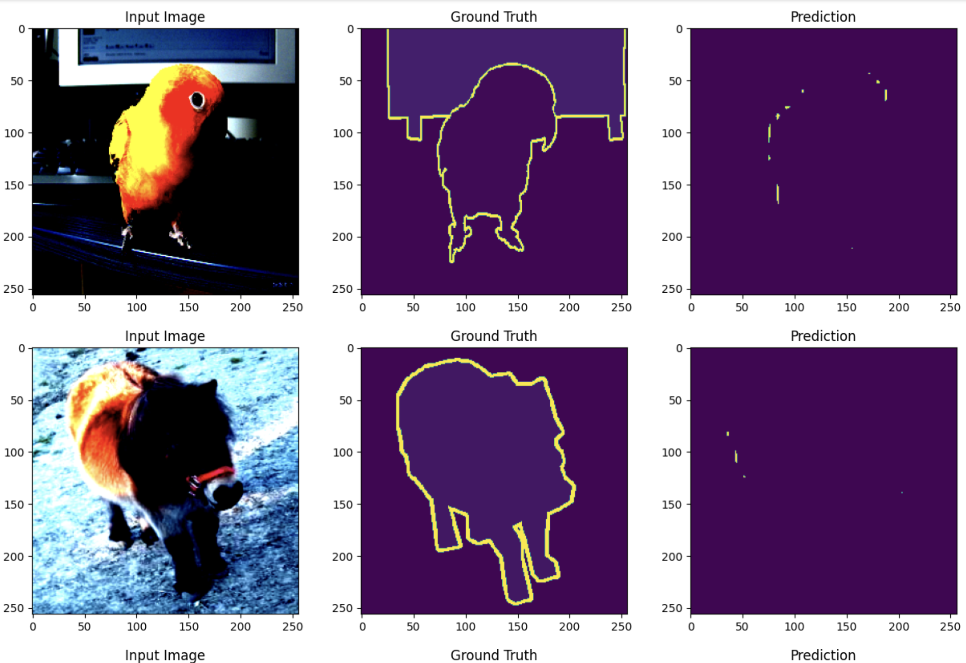
Results
Pixel Accuracy: Achieved 94.43%.
Visual Results: Screenshots of segmented images showcasing the model's performance.
Unsure about prediction visualization,

Slide 9
Evaluation Metrics
Pixel accuracy as a key performance metric.
Visual inspection for qualitative analysis of segmentation results.

Slide 10
References
Pascal VOC Dataset: http://host.robots.ox.ac.uk/pascal/VOC/
Cityscapes Dataset: https://www.cityscapes-dataset.com/dataset-overview/

Slide 11
GitHub Link to the Project
https://github.com/Prabin16/PyTorchProject

